Slide 1
David’s Property Management Website
Team:
Jake Bradford n9190007
Ricky Phan n9562982
Michael de Closey n9165924
Jason Trapp n8828512
Phuoc Nguyen n9173609

Slide 2
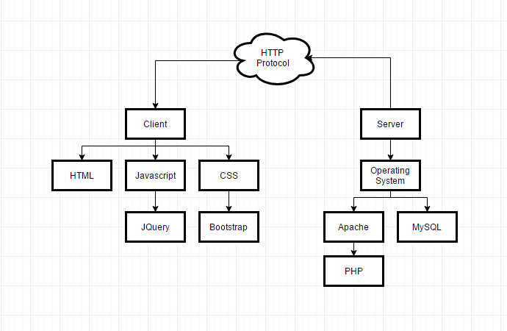
System Architecture

Slide 3
System Architecture
Heroku –free, easy to deploy for applications and connects with GitHub
PHP – for server-side requests
MySQL – to store data
JavaScript – to perform non-server related tasks
HTML – webpage structure
CSS – webpage styling

Slide 4
Sprint 1 Release
Database:
Search results come from data stored internally into the websites system.
Story dependencies
S5 Tenant Details Storage
S6 Staff Details Storage
S9 Contract Details Storage
S11 Owner Details Storage

Slide 5
5
Tenant Details Storage
Could
2
•As a staff member I need to be able to save all the tenants details so that I can review tenants later
Acceptance Criteria
Website records tenant account details
Webpage displays tenant details
Cannot record the same tenant twice
Required fields can’t be blank
Notes

Slide 6
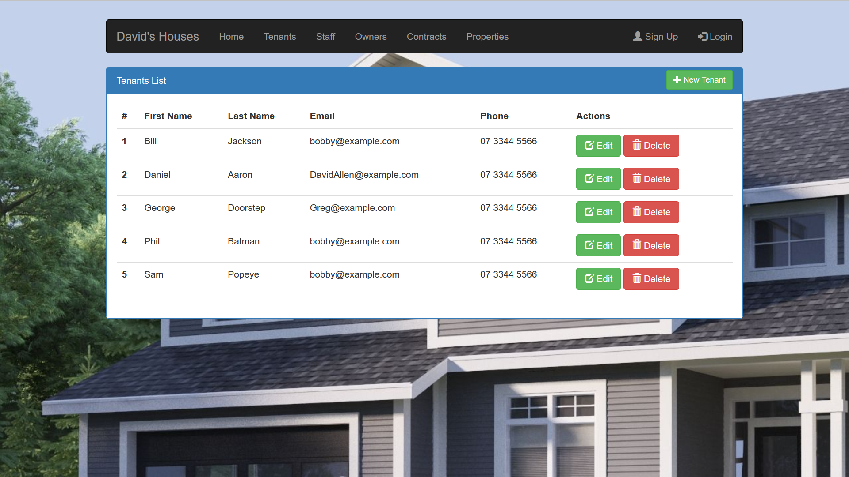

Slide 7
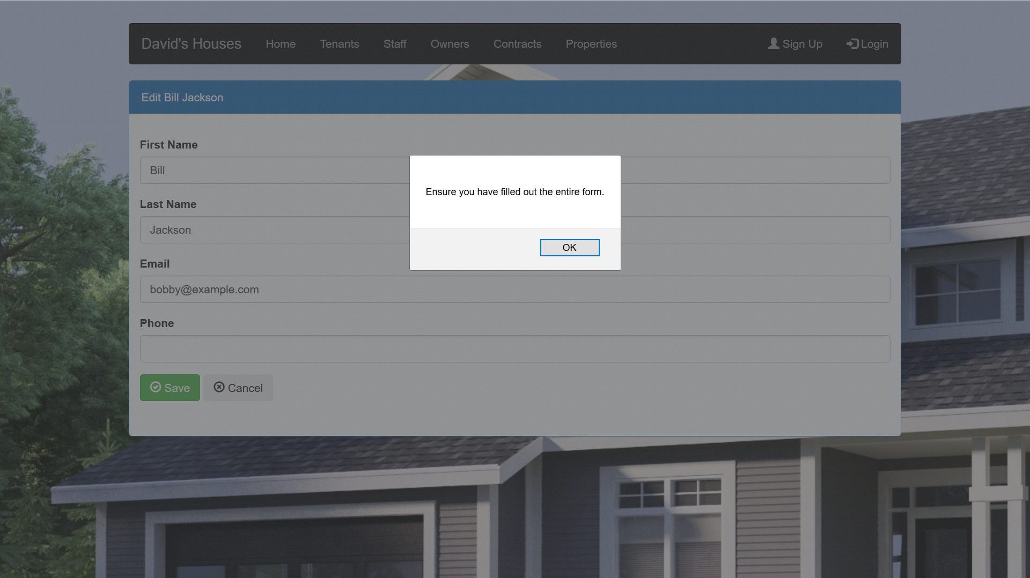

Slide 8
6
Staff Details Storage
Must
2
•As David, I want to record the details of staff so that I can review their details later
Acceptance Criteria
Website records Staff details
Webpage displays Staff details
Staff can’t access personal records
Required fields can’t be blank
Notes

Slide 9
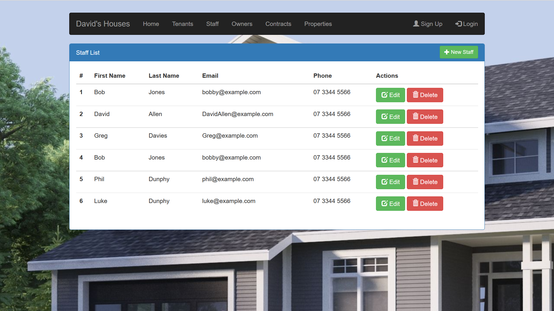

Slide 10
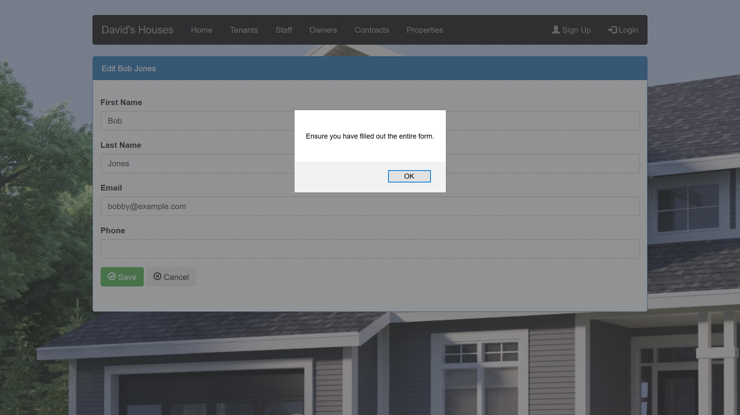

Slide 11
9
Contract detail storage
Must
2
•As a staff member, I need to be able to record contract details so that I can lease properties to a prospective tenant
Acceptance Criteria
Website records contract details
Website displays contract details
Required fields can’t be blank
Only staff can record details
Notes

Slide 12
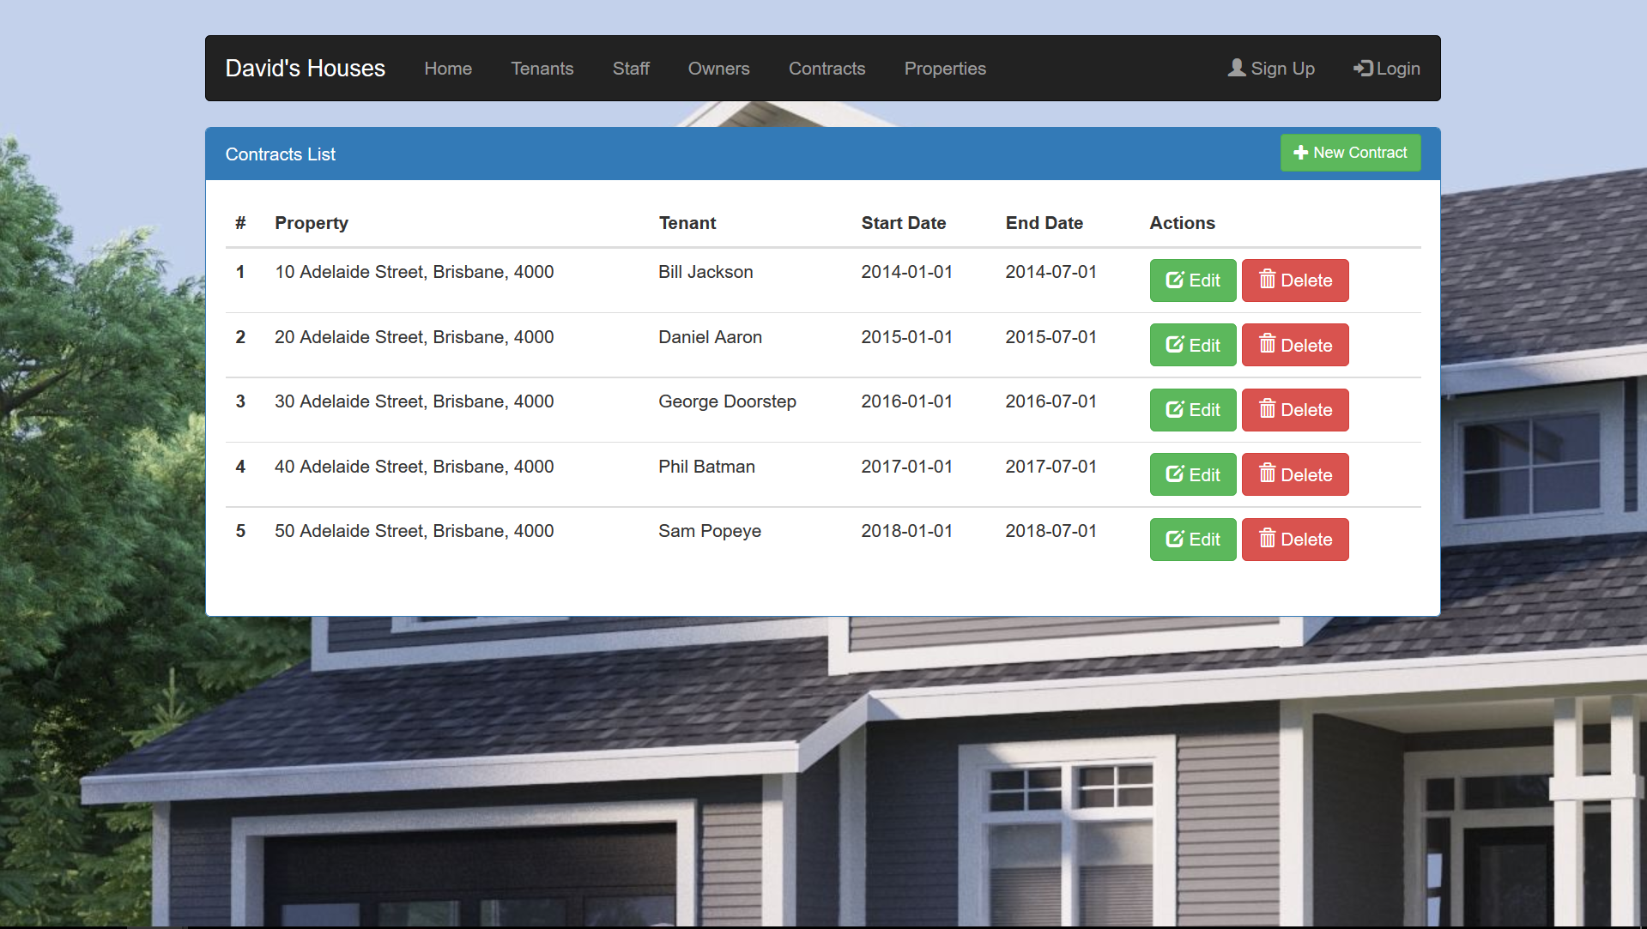

Slide 13
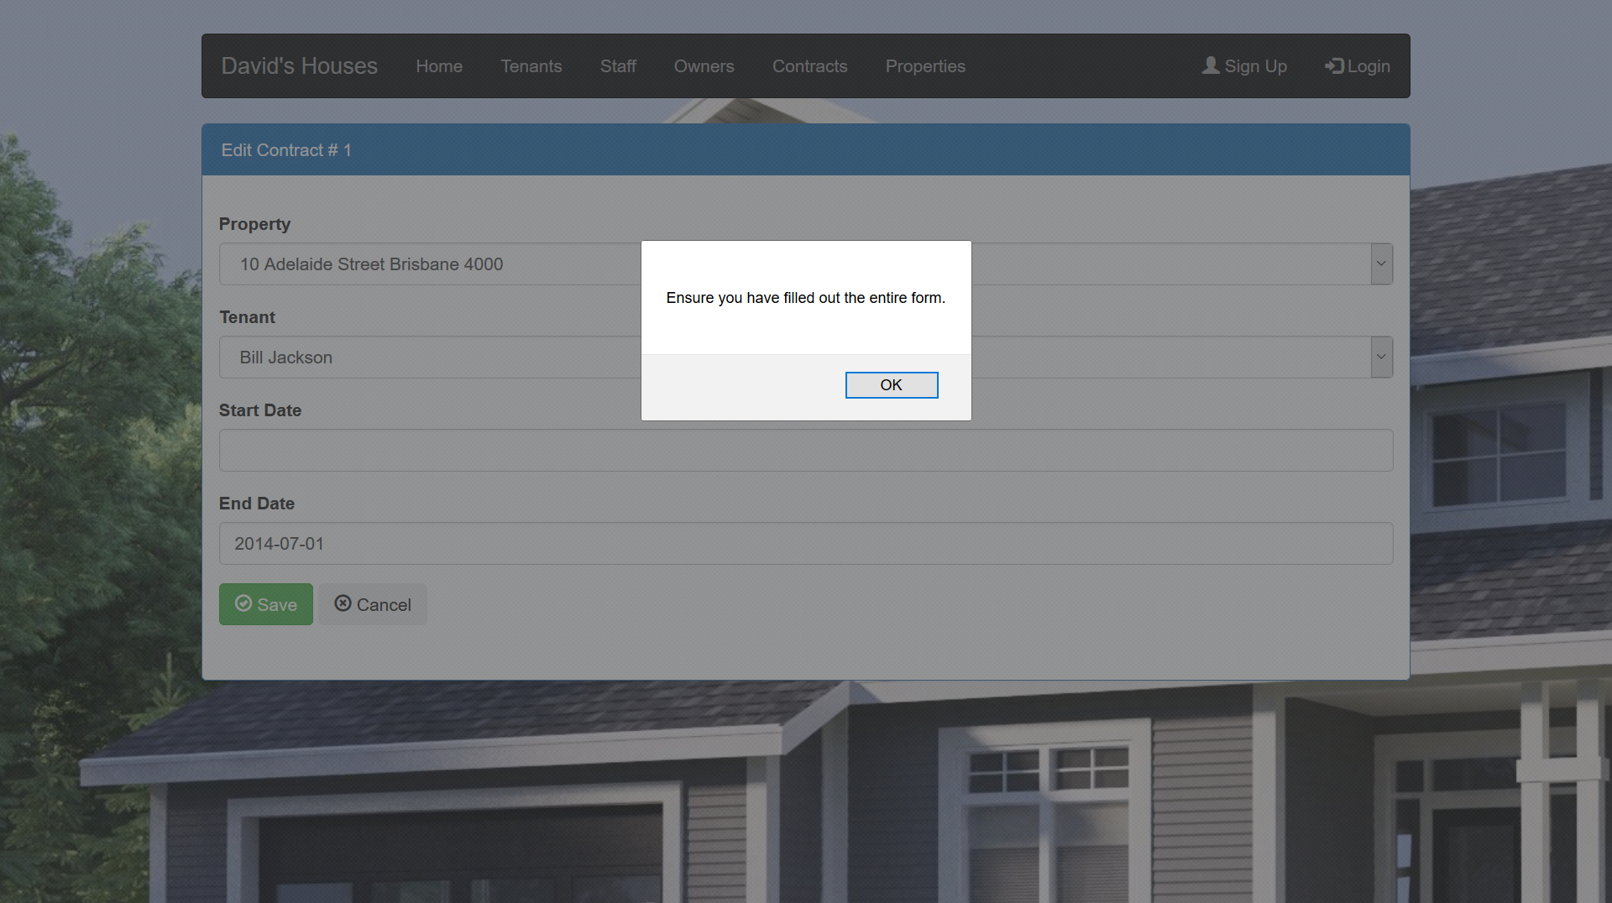

Slide 14
11
Owner detail storage
Should
4
•As David, I can enter the details of property owners so that I can review their details later
Acceptance Criteria
Property owner details visible
Website records property owner details
Only David can enter details
Required fields can’t be blank
Notes

Slide 15
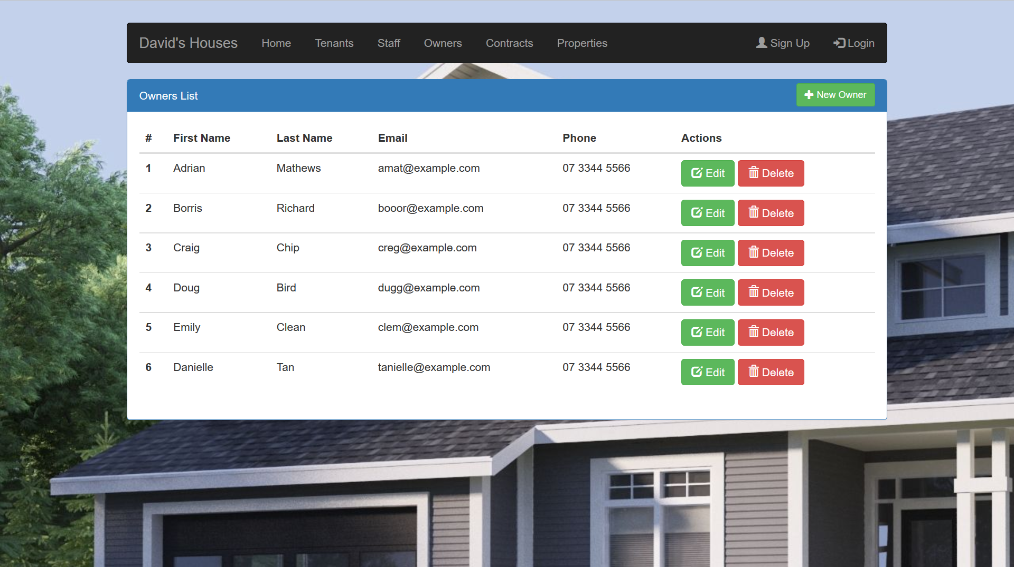

Slide 16
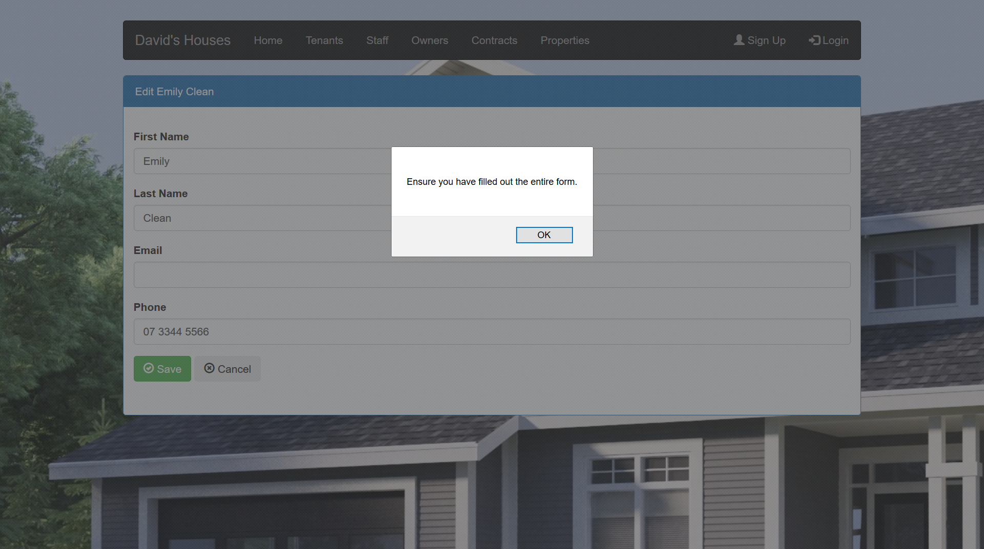

Slide 17
Sprint 1 Release
Searching:
Users can search for properties using keywords
Story dependencies
S2 Property Search
S3 Viewing Times

Slide 18
2
Property Search
Could
1
•As a prospective tenant I need to be able to search for properties so that I can find properties I may want to live in
Acceptance Criteria
Visible search bar
Search produces results page
Page displays error if invalid search
Notes

Slide 19
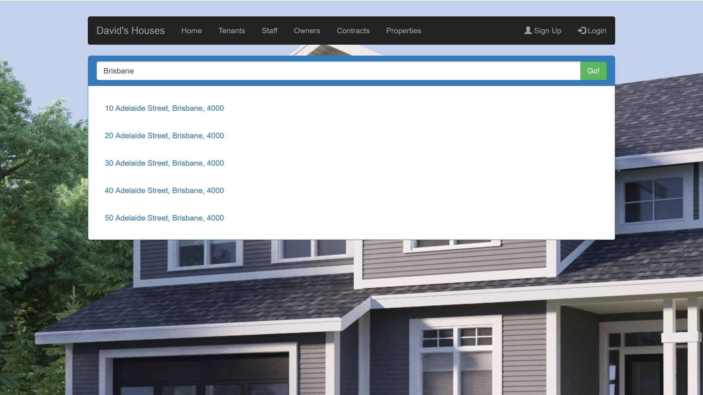

Slide 20
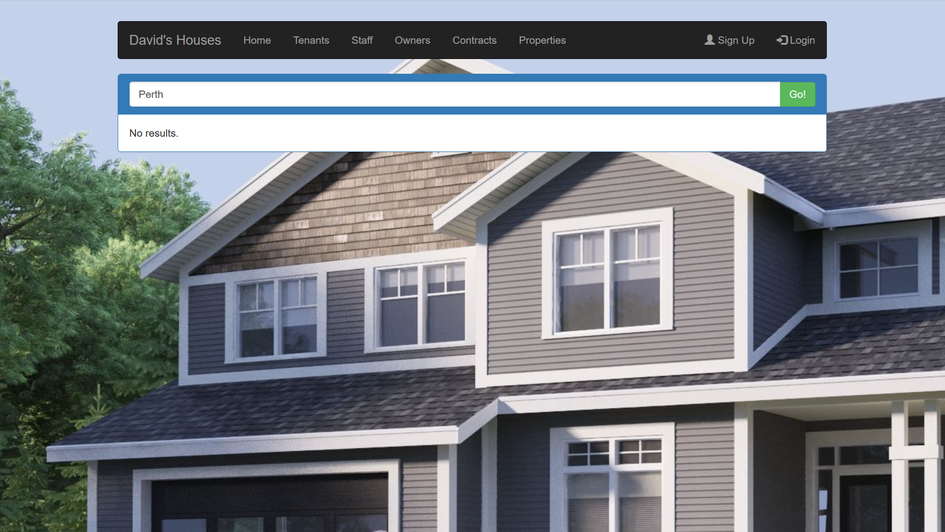

Slide 21
3
Viewing Times
Must
2
•As Staff I need to set a date and time for property viewings so that prospective tenants can visit properties
Acceptance Criteria
Visible inspection times
Times can be set by staff
Times can be changed by staff
Blank if no time set
Notes

Slide 22
Amendments/Sprint 2
Viewing times will be amended when permissions are resolved in Sprint Release 2.
Property details for Sprint Release 2 is already partially completed.

Slide 23
Questions

